Slide 1
INTERNATIONAL STRATEGIC PLAN
UNIVERSITY OF ALICANTE
Joaquín Marhuenda
Vice-President for Institutional Studies Planning at UA
TEMPUS: QATMI FINAL CONFERENCE
21.10.2011
Taras Shevchenko National
University of Kiev

Slide 2
INDEX
INTRODUCTION
UA GENERAL STRATEGIC PLAN
SECTOR: INTERNATIONALIZATION AT UA AND IT´S STRATEGIC PLAN

Slide 3
INTRODUCTION

Slide 4
THE IDEA OF A STRATEGIC PLAN AT UA
The University of Alicante is an opened, dynamic, active and innovative university thanks to the work and commitment of all her members during more than 27 years
To make sure a long term successful path and future of the University it is necessary to plan and debate what is best to be done for the University
Thus …. in May 2006 the Board of Directors of the UA aware of the near future changes, the challenge of the University of the 21st century and, convinced of the necessity of an efficient, transparent and with a future vision management, decided to draw up a Strategic Plan of the UA

Slide 5
DRAWING UP THE STRATEGIC PLAN AT UA
From September 2006 the group in charge to draw up the Plan started to work together with all members of the University community: students, professors, administrative staff , different services and society
A special web site was created where all documents where published during the development and update of the Plan
http://www.ua.es/es/presentacion/pe/plan/index.html

Slide 6
THE STRATEGIC PLAN AT UA
The final document on the Strategic Plan of the UA (with perspectives to 2012) was approved and published in October 2007
http://www.ua.es/es/presentacion/pe/plan/documentos/PEUA.pdf
Each year a Report on the monitoring is published on the same web site

Slide 7
STRATEGIC PLAN AT THE UA

Slide 8
METHODOLOGY: MODEL
MISSION
VALUES
GROUPS
KEY FACTORS
STRATEGIC AXES
SCENARIOS
SWOT
VISION
OBJECTIVES
INDICATORS
ACCTIONS

Slide 9
WORKING GROUP
COORDINATORS:
Maria Cecilla Gómez Luca
Juana Dolores Jordá Guijarro
Jose Francisco Molina Azorin
Board of Directors
External advisory:
UNESCO CHAIR Dep. of Univers. Managments of the Polytech. University of Catalunya
Planning group:
All vice rectors and managers of the UA
University community
Professors, students, researchers, etc.

Slide 10
MISSION
The mission is the existencial reason of the UA:
The University of Alicante is a public, dynamic and innovative institution, with international perspectives and an international reference campus, Whose MISSION is to provide integral trainings to its students with a commitment with the progress and society improvements, through the creation and transfer of technology as well as the cultural, scientific and technological development

Slide 11
VALUES
The values represent the main reference to guide University´s behaviour. At the UA the following values are the guidelines:
Quality
Social commitment
Environmental awareness
Cooperation for development
Equality
Integration
Participation
Critical thought
Tolerance
Transparency

Slide 12
PARTICIPANTS/GROUPS
Those people or groups, have a commitment with University´s mission:
Students
Administrative and services staff
Lecturers, professors
Shell Company´s and UA´s Foundation staff
Concessionaires ´and contracted company´s staff
Students of the Permanent University of the UA
Students and teaching staff from secondary education
Former students
scholarship holder
Providers
Families of the Members of the University Community
Enterprises
Financial entities
Labour Union´s, etc.

Slide 13
KEY FACTORS
The key factors are those that affect the performance of the mission and on which there is no direct jurisdiction:
Population: birth-rate, immigration, etc.
Technology and knowledge evolution
Social evolution: social policy, labour market, training request, cultural factors, mass media.
Economical evolution
Globalization effects
External funds
Policy: educational, research, European.
Competence: other universities, virtual trainings, other higher education alternatives
Territorial policy

Slide 14
STRATEGIC AXES
The strategic axes are the areas and activities considered to be key for accomplishment of the mission:
Human factor
Training
R&D
Management and organization
Infrastructure
Communication and social perspectives
Internationalization

Slide 15
SWOT
Strengths Well established membership and commitment between society and university Campus with best recommendations Technological infrastructure Research groups internationally recognized Stable relationship society-university | Weakness Little assessment, coordination and improvement of the teaching staff Lack of space and insufficient management of It s use Lack of adequate management system of Human resources Poor individuals and groups integration in and institutional project Organic structure poor functional
Opportunities University prestige thanks to its cultural leading and social commitment; Scientific Part - already a reality Positive appearance of the UA in the mass media Privileged geographical location EHES for its internationalization and teaching quality | Threats Other in neighbourhood Universities and Institutions competence; Poor prevision of Public Funds Lack of a strategically designed educational policy at national level Poor participation of some social sectors in the UA Projects Rigid legislations that affect directly the University´s sector

Slide 16
VISION
The vision of the Future of the UA to be achieved by 2012.
Most of the following targets are already archived:
A Prestigious University, internationally respected and a Reference of the Alicante City and it´s social environment
Participative and motivated students, with a self-learning capacity and good knowledge for their employment in an international Labour Market
A wide and high-quality Degrees variety in the EHES, adapted to the requests of the Labour market and oriented to an integral and lifelong learning education
Internationally recognized basic and applied research supporting the Scientific Park generating a high impact on the socio-economic domain.

Slide 17
VISION
There is a flexible, motivated and potential Human Development System and Strategic Planning, as well as efficient and competent staff, well dimensioned , organized and fully recognized
Strategic Management System at all levels with the objective to fulfil the Strategic Plan of the UA
A fluid relationship with social agents
Provide adequate, sustainable and well managed spaces, infrastructures and services for the entire University community
Increased students and teaching staff universities exchange. Increased number of foreign students and cooperation projects.

Slide 18
STRATEGIC OBJECTIVES
The Strategic objectives, structured in accordance with the axes, are the proposed aims for the achievement of the vision of the future of the UA. They are set in operative objectives that are the general actions for the achievement of each strategic objective:
SO1. Human Component
SO2. Training
SO3. R&D
SO4. Management and Organization
SO5. Infrastructure
SO6. Social communication and implication
SO7. Internationalization

Slide 19
STRATEGIC OBJECTIVES
SO1. Human Component:
To achieve a competent, efficient and satisfied staff committed with the University's values
To obtain students implication in the University´s mission and make them active agents in the achievement of the University´s vision
SO2. Training:
Restructure the educational offer adapted to the EHES, in accordance with social and Labour necessitates and guaranteeing teaching quality
SO3. R&D:
To develop high quality, competitive and internationally referred research
To achieve high rate of technological development and innovation related to research through Scientific Park
SO4. Management and Organization:
To achieve an efficient management through a Strategic Management System at all levels and organizational structures

Slide 20
STRATEGIC OBJECTIVES
SO5. Infrastructure:
To provide adequate spaces, infrastructure and services
To guarantee the ITC provision as tool for the services
SO6. Social communication and implication:
To achieve the social environment to perceive the UA as an excellent reference
To provide an efficient and valuable internal communication that would take into consideration all relevant aspects of the University community
SO7. Internationalization
To consolidate and develop relationships with prestigious universities and research centres ant to participate in international programmes
To guarantee cooperation actions of the UA with a positive and high-quality impact on economy and society

Slide 21
SECTOR: INTERNATIONALIZATION AT UA AND IT´S STRATEGIC PLAN

Slide 22
STRATEGIC AXES
A1. INTERNATIONAL POLICY
A2. DEVELOPMENT COOPERATION
A3. FINANCING
A4. HUMAN RESOURCES
A5. ORGANIZATION AND MANAGEMENT
A6. SOCIAL COMMUNICATION, IMPLICATION AND PROMOTION
A7. FOREIGN LANGUAGES

Slide 23
A1. INTERNATIONAL POLICY
Support and promote the internationalization of the UA
1.1. Consolidate and expand links with major institutions
1.2. External promotion of the UA

Slide 24
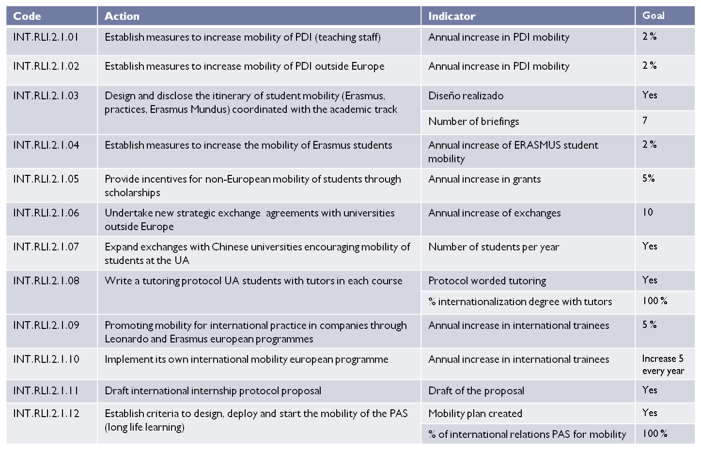
A1. INTERNATIONAL POLICY
Improve quality and increase the international mobility
2.1. Increase the UA members mobility with quality criteria

Slide 25
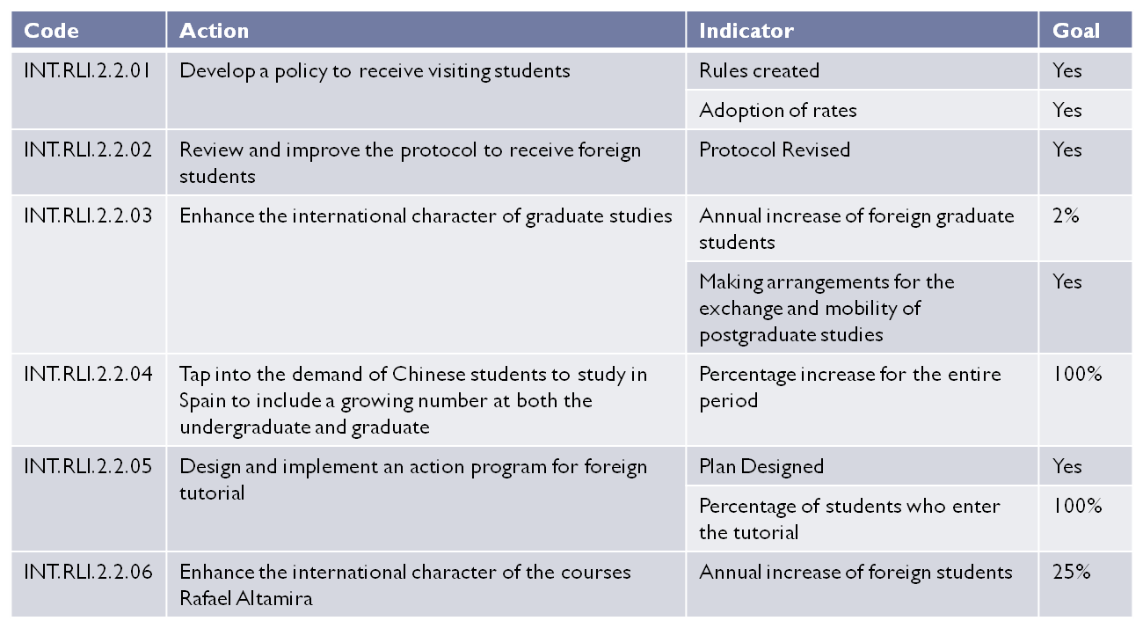
A1. INTERNATIONAL POLICY
2.2 Increase the number of foreign students with quality criteria

Slide 26
A2. DEVELOPMENT COOPERATION
Improve and enhance human development projects in countries with lower HDI according to the Millennium Development Goals
1.1. Implement methodologies and tools for project planning university cooperation for development according to criteria established by the European Union

Slide 27
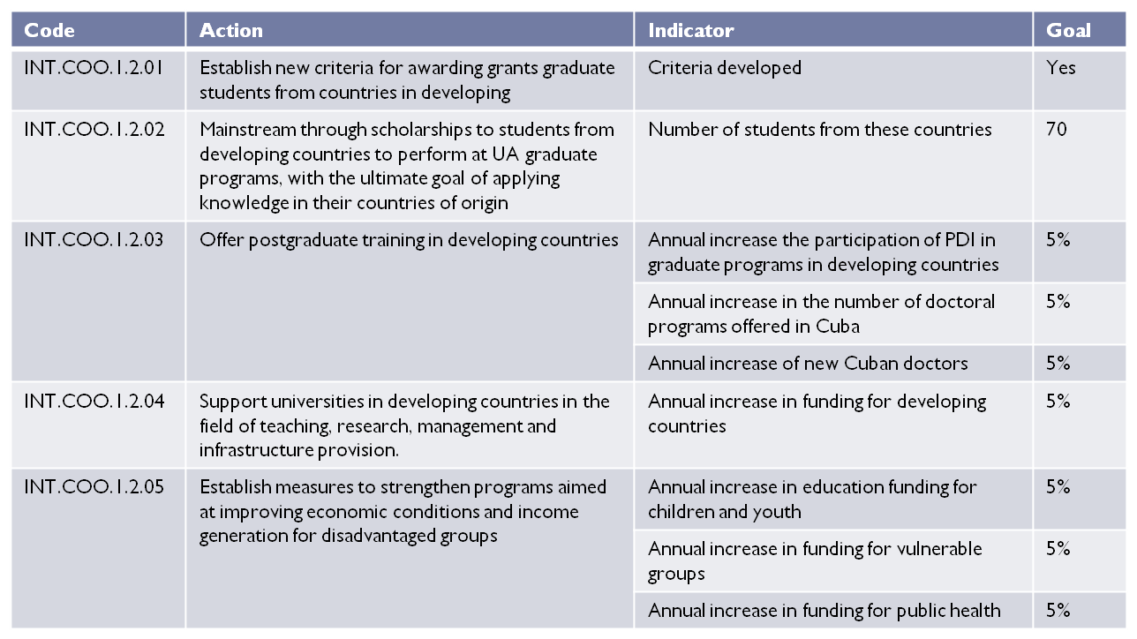
A2. DEVELOPMENT COOPERATION
1.2. Promote actions aimed at economic, social and human development of disadvantaged people

Slide 28
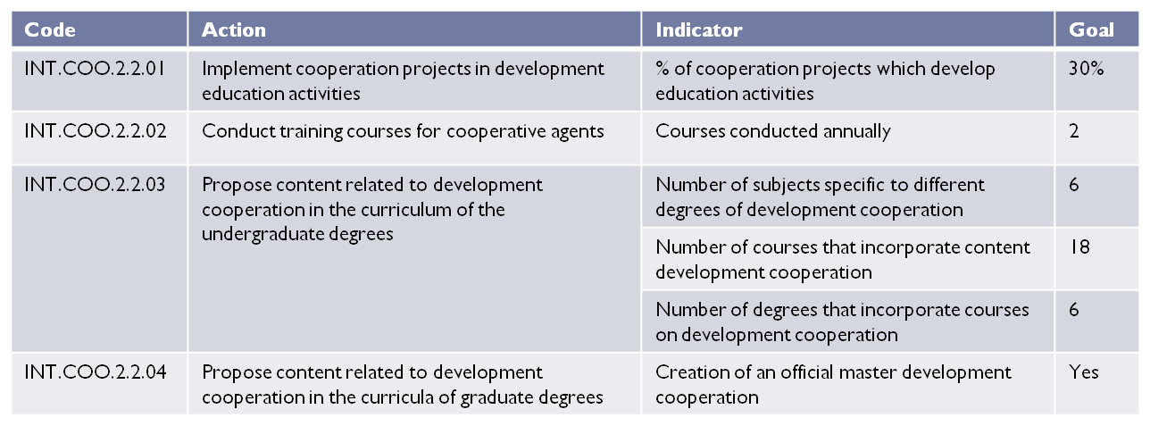
A2. DEVELOPMENT COOPERATION
2. Promoting understanding on cooperation and solidarity values
2.1. Establishing awareness programs
2.2. Promote education development (within and outside the UA)

Slide 29
A3. FINANCING
Increasing funding for actions under international sectoral strategic plan
1.1 Increasing amounts derived from existing sources.
1.2 Access new sources of funding
Code | Action | Indicator | Goal
INT.FIN.1.2.01 | Contact and increase partnerships with new institutions (foundations, IVEX, ICEX, financial institutions, COEPA, industry associations, companies for individual fellowships, cameral council, city councils, county council, ...) | % of annual increase in funding from new sources over budget | 5%
 |  | Number of new funding sources incorporated annually | 1

Slide 30
A4. HUMAN RESSOURCES
Having sufficient staff with teaching and research, and administrative training and experience to international activity
1.1. Adjust the size and composition of teams of people involved in international management at all levels and units.
1.2. Establish a training program for the acquisition of knowledge and skills necessary to carry out the activities of internationalization
Code | Action | Indicator | Goal
INT.CHU.1.1.01 | Incorporate an administrative with language skills in schools to ensure proper implementation of the tasks of internationalization | % of schools with PAS | 100 %
INT.CHU.1.1.02 | Include jobs with a specific profile in the international offices | % of appropriate offices | 100%
Code | Action | Indicator | Goal
INT.CHU.1.2.01 | Design and implement training on development cooperation for PAS | % of cooperation staff in training | 100%
 |  | Training Plan by office | Yes
INT.CHU.1.2.02 | Design and implement training on design and management of cooperation projects for PDI | Courses conducted annually | 1

Slide 31
A4. HUMAN RESSOURCES
Ensure that the staff is compromised, and sufficiently motivated and supported
2.1. Establish mechanisms for professional recognition.
Code | Action | Indicator | Goal
INT.CHU.2.1.01 | Clarify the mechanisms of recognition of activities related to internationalization for the PDI (POI) (eg, tutors) | Introduce in POI international recognition of activities POI | Yes

Slide 32
A5. ORGANISATION AND MANAGEMENT
Getting an organisation fully adapted to the internationalisation through a structure, a system of communication and a common foreign policy
1.1. Get fast and efficient management using strategic planning system.
Code | Action | Indicator | Goal
INT.GES.1.1.01 | Design and create a mobility and international relations, office with defined roles, to manage programs and support the Vice President and the centers | Mobility and International Relations Office created | Yes
INT. GES.1.1.02 | Design and create an office for cooperation, to support all activities in this area | Cooperation Office created | Yes
INT. GES.1.1.03 | Strengthen the Academic Committee of International Relations by providing it with a regulation which establishes its functions and composition. | Regulations established | Yes
INT. GES.1.1.04 | Redefine the powers and composition of the Partnership and provide it with a new regulation establishing their functions. | Regulations established | Yes
INT. GES.1.1.05 | Manage and monitor centrally funded cooperative projects | % of cooperation projects centrally managed with regional financing | 100%
 |  | % of cooperation projects with state funding or other with centralized tracking | 100%

Slide 33
A6. SOCIAL COMMUNICATION, IMPLICATION AND PROMOTION
Improving communication and visibility of the University's international image
1.1. Projecting international image of the UA as a benchmark of quality and excellence.
Code | Action | Indicator | Goal
INT.COM.1.1.01 | Dissemination of mobility activities and other international activities carried out by the UA in the UA itself and in our environment aimed at attracting new students | Include information about international activities carried out by the UA in the briefings that are made to institutes in the province | Yes
INT. COM.1.1.02 | Establish mechanisms and develop materials for dissemination of teaching and research activities of the UA | Preparation of written material in different languages ​​with information on studies and research offer | Yes
 |  | Preparation of powerpoint presentations | Yes
INT. COM.1.1.03 | Spread our institutional information to foreign universities and institutions of higher education | Number of annual visits to universities of strategic importance | 1
 |  | Sending information to foreign universities offering studies, scholarships, Spanish, summer courses,, of the UA | Yes
INT. COM.1.1.04 | Spread our corporate information to other institutions and agencies | Sending information to embassies, consulates and Spanish trade offices in countries where we want to establish and maintain our relationship, those embassies and consulates in our country and companies with abroad internships agreements | Yes

Slide 34
A6. SOCIAL COMMUNICATION, IMPLICATION AND PROMOTION
1.2. Foster awareness of the UA as an institution committed to the values ​​of international cooperation
Code | Action | Indicator | Goal
INT.GES.1.2.01 | Create specific dissemination material and advertising of cooperation development | Preparation of promotional videos in different languages | Yes
 |  | Preparation of written material in different languages ​​with information on cooperation activities. | Yes
 |  | Preparation of powerpoint presentations | Yes
INT. GES.1.2.02 | Diffuse into and out the AU cooperation activity of the UA. | Number of annual measures of diffusion | 1

Slide 35
A7. FOREIGN LANGUAGES
Provide the university community of language skills necessary to perform their functions in other languages
1.1. Train teacher, researchers, administrative staff and students in English and other languages. Promote and support professional use of English and other languages
Code | Action | Indicator | Goal
INT.FOR.1.1.01 | Increase participation in language courses offered by the UA | Annual increase of students doing English courses | 10%
 |  | Annual increase in PDI doing English courses | 5%
 |  | Annual increase in PAS that perform general English courses | 5%
INT. FOR.1.1.02 | Create courses with a media component for students | % courses incorporating multimedia component | 30%
INT. FOR.1.1.03 | Flexible course offerings for PAS, PDI and students | Conduct a biannual survey of satisfaction and time preferences | Yes
INT. FOR.1.1.04 | Establish agreements with government agencies to organize tests of language-level recognition | Number of languages ​​in which agreements have been made | 6
INT. FOR.1.1.05 | Increase the number of students in Chinese and Japanese university community for students, PDI and PAS. | Annual increase of students, PDI and PAS that take these courses | 5%

Slide 36
A7. FOREIGN LANGUAGES
1.2. Promote and support professional use of English and other languages
Code | Action | Indicator | Goal
INT.FOR.1.2.01 | Creating a language advisory cabinet for review and correct English teaching materials | Language advisory cabinet created | Yes
INT.FOR.1.2.02 | Write a report of recommendations on the recognition of linguistic competence in future curricula | Report writen | Yes
INT.FOR.1.2.03 | Design a plan for translating curricula into English | Plan designed | Yes
INT.FOR.1.2.04 | Design a plan to translate materials into English | Plan designed | Yes
INT.FOR.1.2.05 | Develop a teaching plan in English | Plan designed | Yes

Slide 37
THANKS FOR
YOUR ATTENTION

